Slide 1
From ddd to DDD
data-driven development
Domain-driven Design
An ongoing journey
Thibaud Desodt - @tsimbalar
Notes:
Add some kind of climbing the mountain images ?

Slide 2

What this is about
Me, myself and I
Code
Architecture
Learning process
Notes:
It’s about me …
My experience
The steps in my learning process
But it can be useful for you ☺
Learn from my mistakes ☺
A bit about code, a bit about architecture, mostly about the learning process

Slide 3


Where it all started
Notes:
Graduated
OO Java
Learnt a bit about Design Patterns
Not much about real software engineering
Internship on the MS stack

Slide 4
PRESENTATION
E-commerce site
ASP.NET / C#
Back-office site
“classic” ASP / VbScript
BUSINESS LOGIC
Stored Procedures
T-SQL
Data
Tables
DATA
Notes:
End of study internship
E-commerce web apps / web agency … I was employee n°3 :P
Frontend / backend + shared db
Frontend = ASP.NET 1.1 / WebForms
Backoffice = ASP classic with VbScript
SQL Server db
“We use Stored Procedures because it’s more efficient”
I’ll skip over the (lack of) proper engineering practices (SourceSafe, shared db for developments, no CI … )
The process :
Design most of the relational model up front (but very inspired / copy-pasted from previous e-commerce projects)
Update it sometimes when needed
Create (lots of) stored procedures for every possible action
It works ok
You work mostly alone
You can fit everything in your head
It’s the initial version and everything is fresh in your head
It’s hard :
Adding new stuff in db model : translations
T-SQL :-/
Automated tests !
Most tables:
Make sense only to admin (catalogue / category administrations)
Make sense only to web site (cart, user info)
Have a mixture of both … (article with flag “published” etc)
Patterns/anti patterns :
- Database integration
You tend to over-engineer things / find workaround to avoid changing things because changing is hard … and there are no automated tests :-/
TODO : a db model with lots of tables ?

Slide 5
And it was …
Not super pleasant
VbScript
T-SQL
Fragile
No automated tests
Tight coupling
Schema -> Stored Procs -> Website / admin site

Slide 6

… but it worked “well enough”!
Customer value
Happy customer
Fast delivery of features
Reasonable perf
Easy to work on
1 feature ≈ 1 stored procedure

Slide 7
It worked well ... in that context
Working alone on project
Version 1 of the product
Well-defined requirements
Tight interactions with customer
Simple domain
= ideal greenfield project
Notes:
In such an ideal case, the architecture, the tech stack do not really matter … do whatever floats your boat

Slide 8
A few years later …
Similar approach, different context

Slide 9
A different context
40,000+ employees company
100s of developers spread across the globe
Many different systems accessing the database(s)

Slide 10
B2B SOAP services
Customer-facing web apps
Internal Catalogue app
That excel sheet nobody understands
3000+ Stored Procedures
T-SQL
Data
800+ Tables
Quotation app
Admin CRUD app
This scripts that runs every night
Reporting App
Bob running random SQL queries
The Enterprise Database ™
Notes:
Years later , other company
“the shared database”
One single database + replicated copies in several places. (actually, another db “metadatabase” with info about the database … version schema etc)
+ tools to actually manage the db
The source of truth, shared between app.
The database committee: change requestes are analyzed and accepted or rejected monthly …
Dev Db Version > Prod version …. Synchronization for deployments
It totally sucks !
Db changes requested by Business Analysts

Slide 11
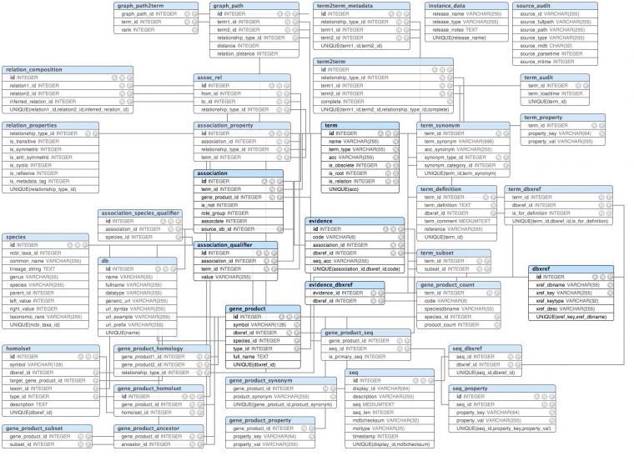
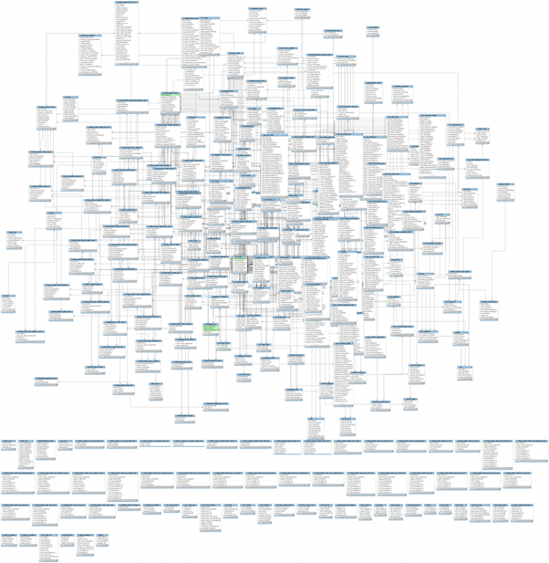
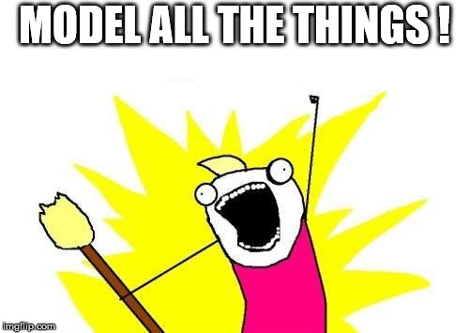
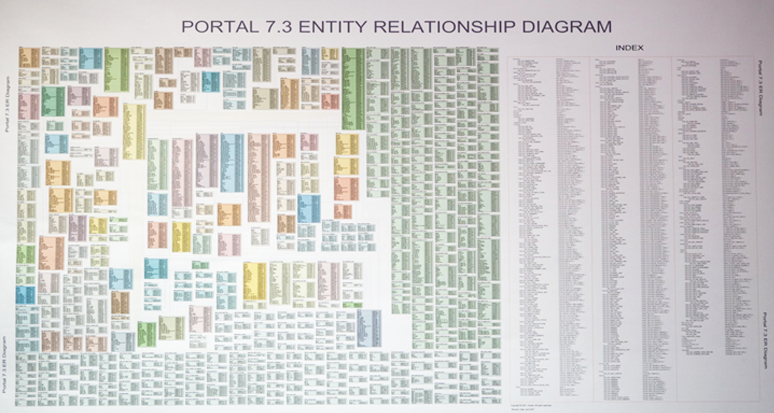

Slide 12
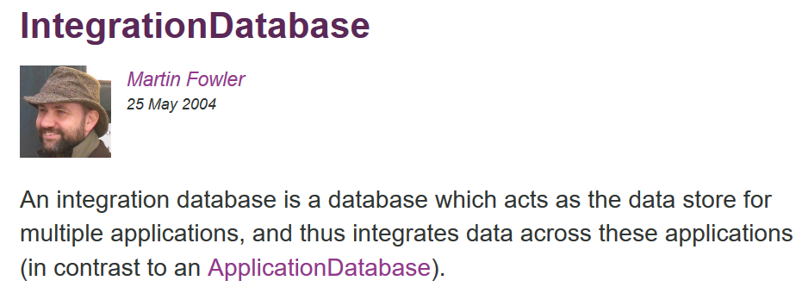
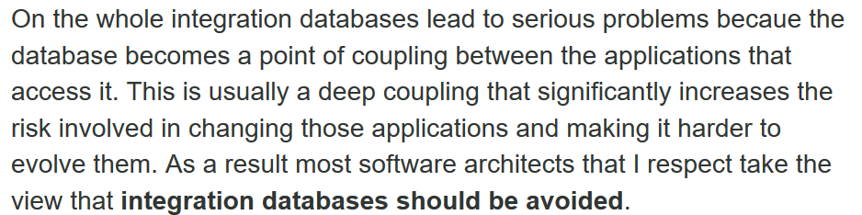
(…)

Slide 13
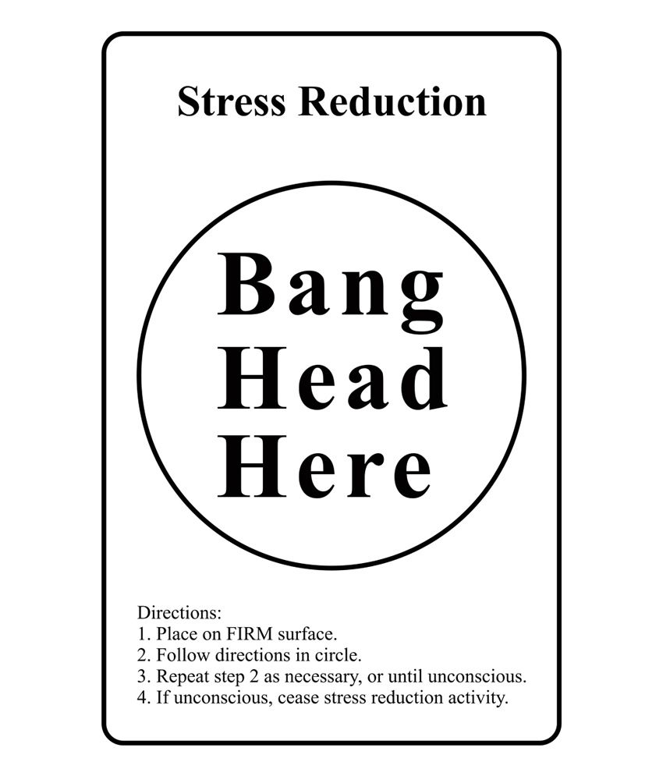
Many issues
Evolution is hard
Testing is hard
Versioning / collaboration is hard
Performance is not great

Slide 14
the “solution” ….
Team of 50 DBAs
The “database” committee
The “database” change process
The “meta-database”
Db replication
Governance
Technical solutions
… to solve technical issues
… introduced because of technical decisions
… with no value to the users
= Accidental complexity

Slide 15

Notes:
Once you’ve reached that point, it’s going to be hard to keep on producing value
I’d like to tell you we moved out of that mess … but I quit U_U

Slide 16
Moving away from database-driven
Persistence is an implementation detail
Focus on customer value
Relational DB, Document DB, Key-Value store, file …
Who cares ?
Business > Tech

Slide 17
Bringing the logic back to the code
PRESENTATION
App
PRESENTATION
BUSINESS LOGIC
DATA
DATA
BUSINESS LOGIC
Notes:
End of study internship
E-commerce web apps / web agency … I was employee n°3 :P
Frontend / backend + shared db
Frontend = ASP.NET 1.1 / WebForms
Backoffice = ASP classic with VbScript
SQL Server db
“We use Stored Procedures because it’s more efficient”
I’ll skip over the (lack of) proper engineering practices (SourceSafe, shared db for developments, no CI … )
The process :
Design most of the relational model up front (but very inspired / copy-pasted from previous e-commerce projects)
Update it sometimes when needed
Create (lots of) stored procedures for every possible action
It works ok
You work mostly alone
You can fit everything in your head
It’s the initial version and everything is fresh in your head
It’s hard :
Adding new stuff in db model : translations
T-SQL :-/
Automated tests !
Most tables:
Make sense only to admin (catalogue / category administrations)
Make sense only to web site (cart, user info)
Have a mixture of both … (article with flag “published” etc)
Patterns/anti patterns :
- Database integration
You tend to over-engineer things / find workaround to avoid changing things because changing is hard … and there are no automated tests :-/
TODO : a db model with lots of tables ?

Slide 18
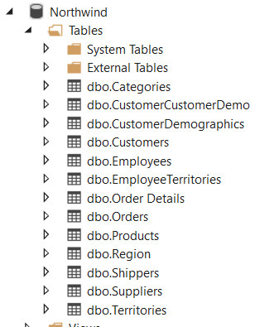
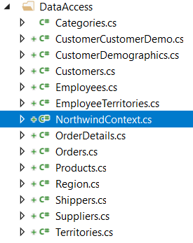
Bringing the logic back to the code
No more Stored Procedures
ORM (Entity Framework in that case)
Data-access code + Entities* generated from database
* Not quite

Slide 19
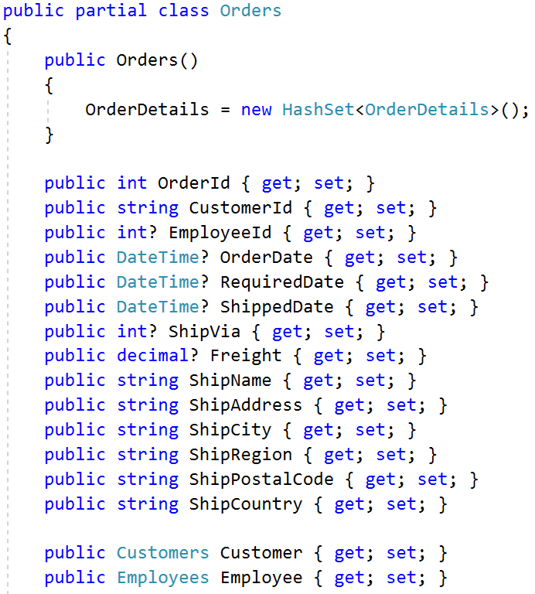
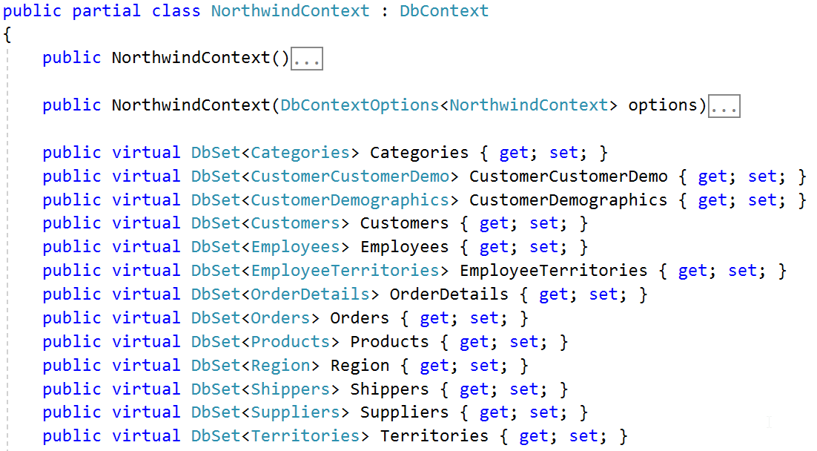

Slide 20
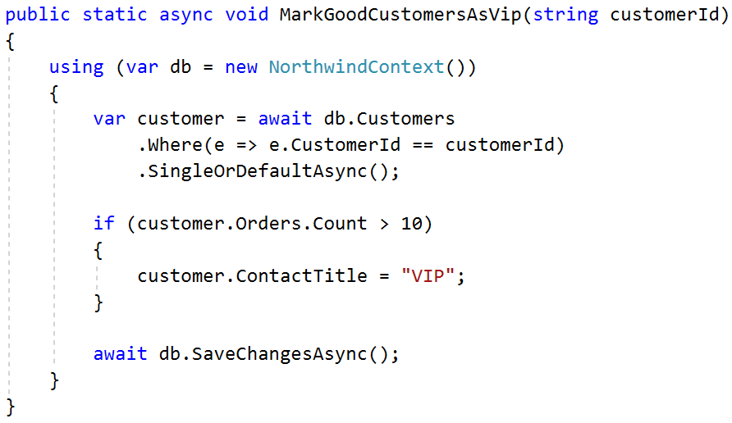
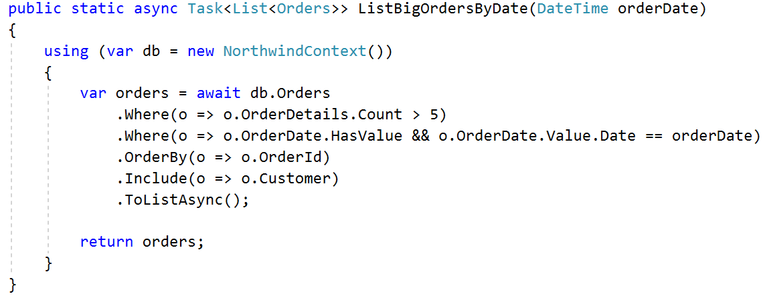

Slide 21
Status
That’s better !
No more business logic in the DB
Quite readable
Still a bit messy:
Not testable
Hard coupling
BUSINESS LOGIC
DATA

Slide 22
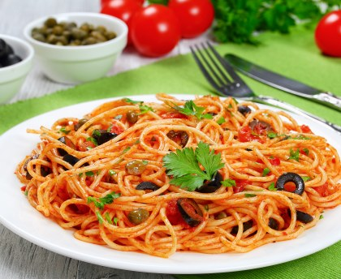
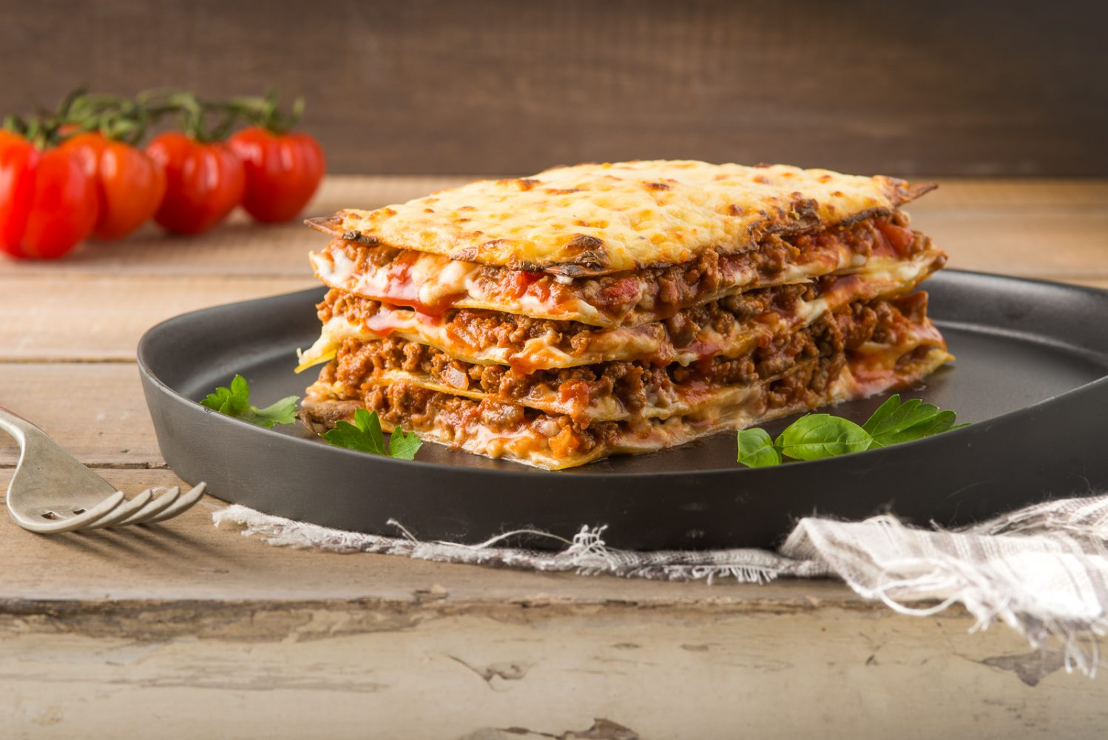
Better layering

Slide 23
Better layering
BUSINESS LOGIC
Services
Repositories
+ Unit of Work
Orchestrate data-flow for a given use-case
DATA
Abstract away details of how data is accessed

Slide 24
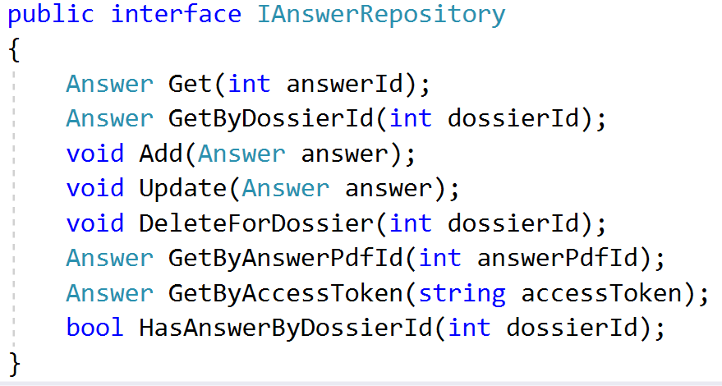
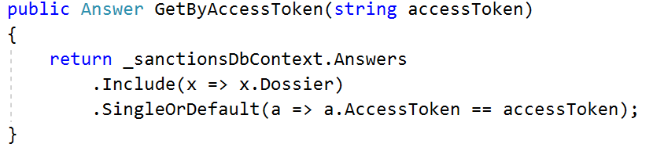
Repository

Slide 25
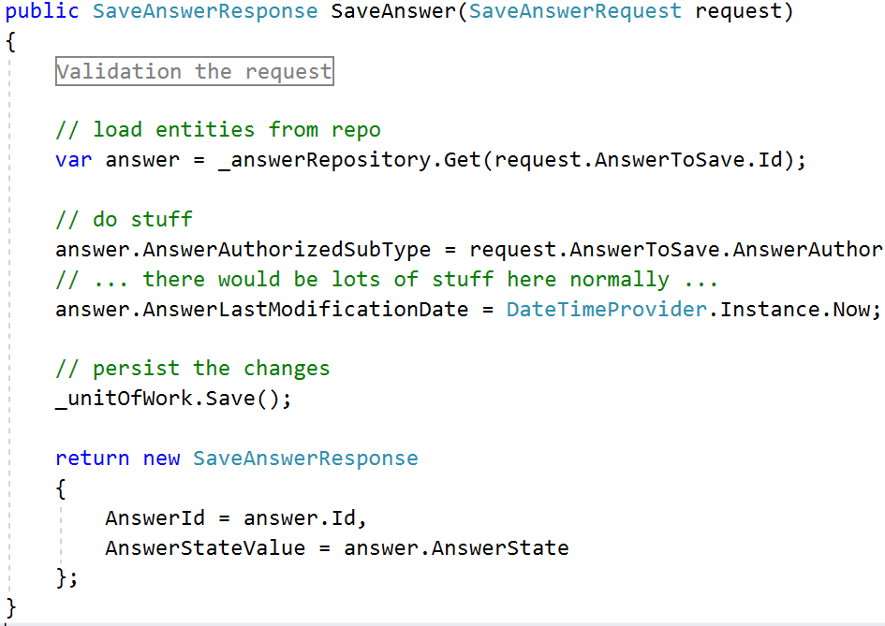
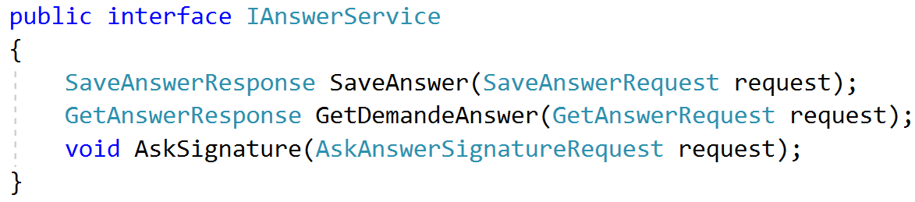
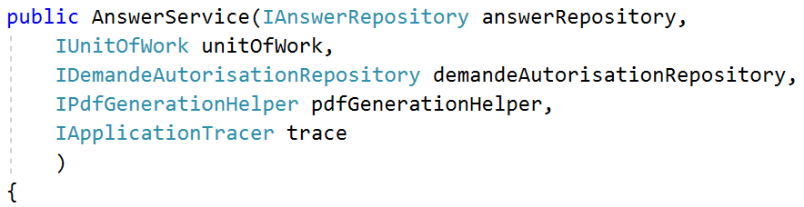
A “Service”
Notes:
Request / Response

Slide 26
Status
Quite an improvement
Decoupled
Testable
Easy to know where functionality should live
It worked fine initially
But … wait a minute …

Slide 27
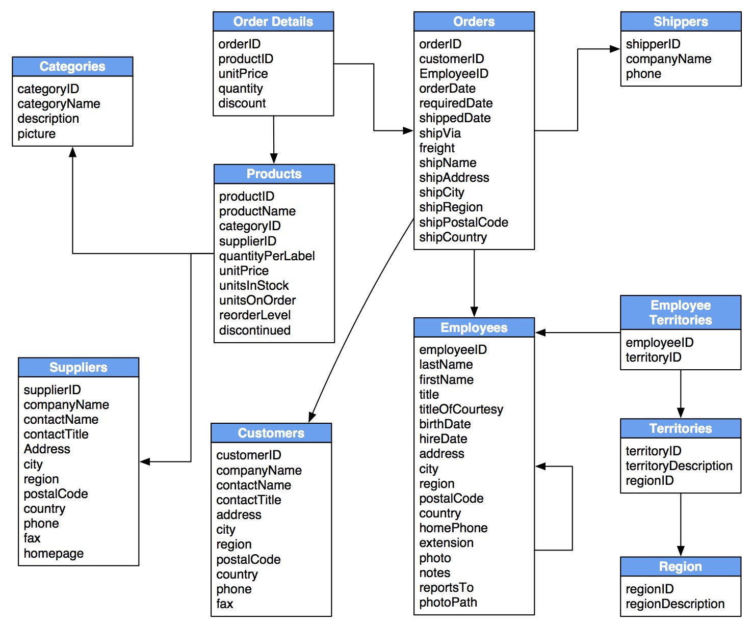
Object graphs
When loading an Order from DB …what else should I load ?
All the relationships ?
Some of them, and leave some unpopulated (null) ?
Some of them, and use lazy-loading ?
define Aggregates
Deliberately delimit clusters of objects that
live together and are loaded/stored together.
… keep them as small as possible
Notes:
May need denormalizing

Slide 28
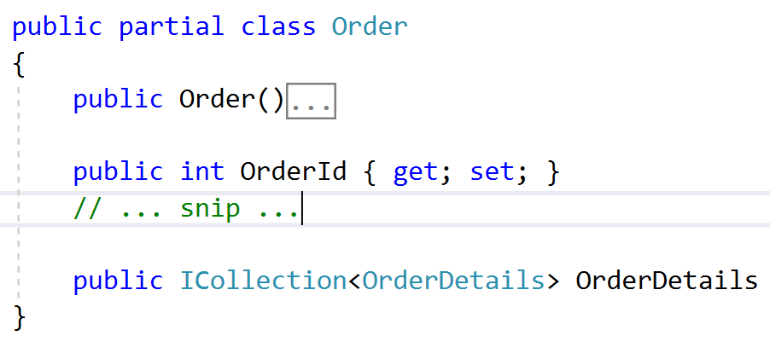
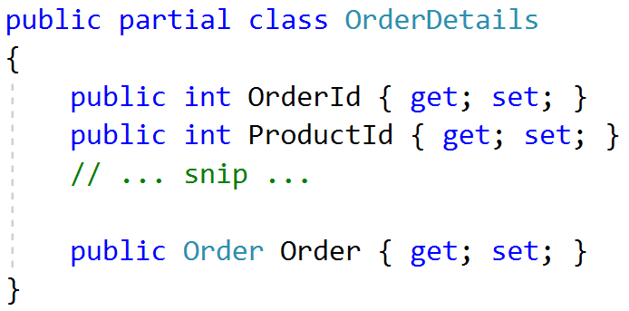
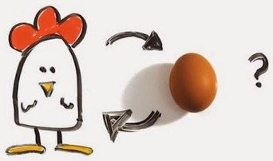
Object graphs
identify the Aggregate Root
The unique entry point to the graph
Dependencies go only in one direction
Repositories return Aggregates through their root

Slide 29
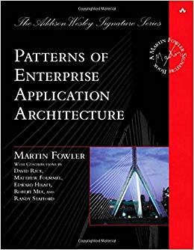
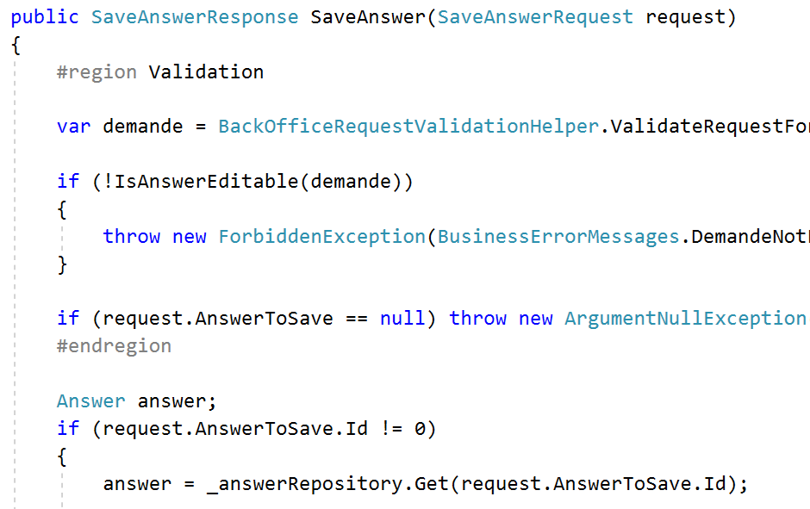
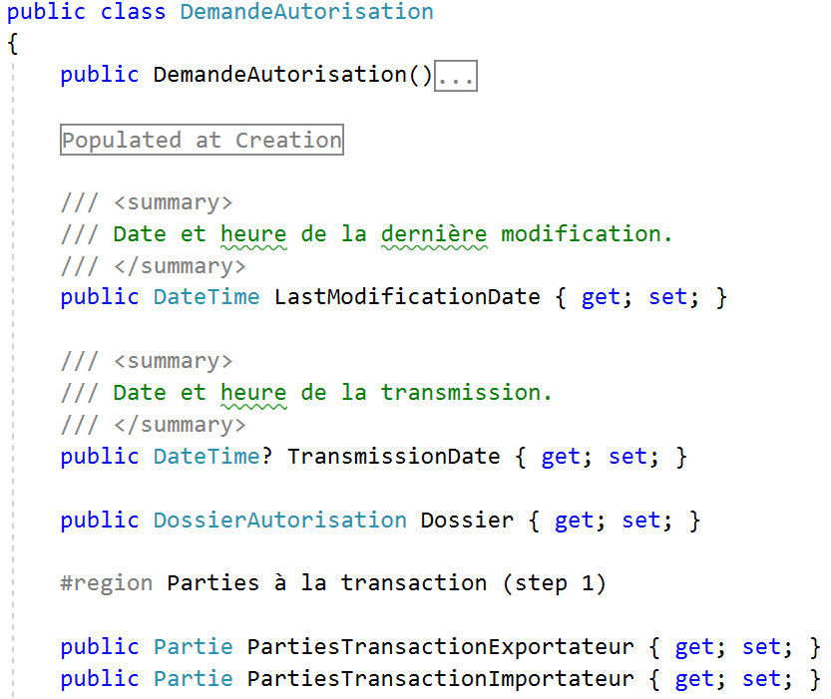
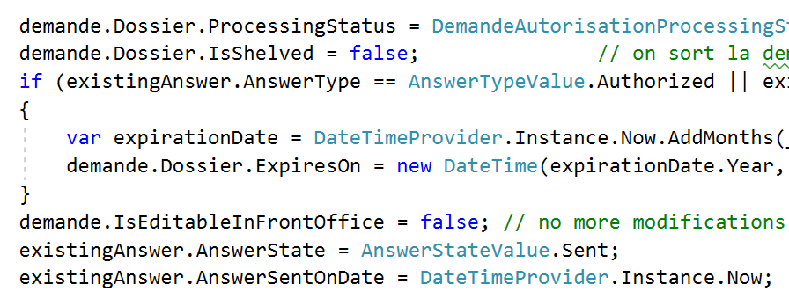
More smells …
Transaction Script
Anemic Domain Model
Notes:
Lots of duplication

Slide 30
Fighting the Anemic Domain Model
Do not expose setters
Do expose only the Aggregate Root
Do enforce invariants (guard clauses)
Do mutations only through methods
Use intent-revealing names (no Update(…) methods)
Make invalid states impossible to represent
Notes:
Methods to keep track of the intent

Slide 31
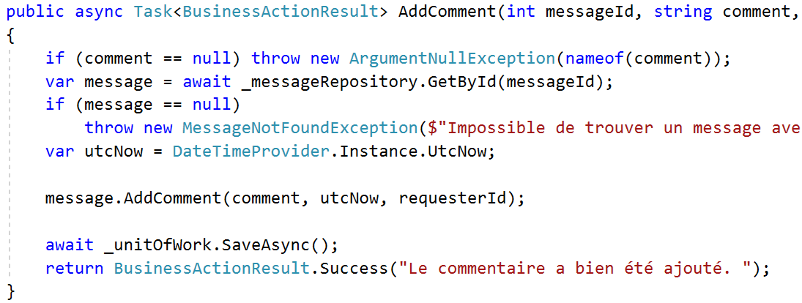
Transaction Script -> Application Service
1. Load aggregate root from repository
2. Mutate by invoking methods
3. Save to DB

Slide 32
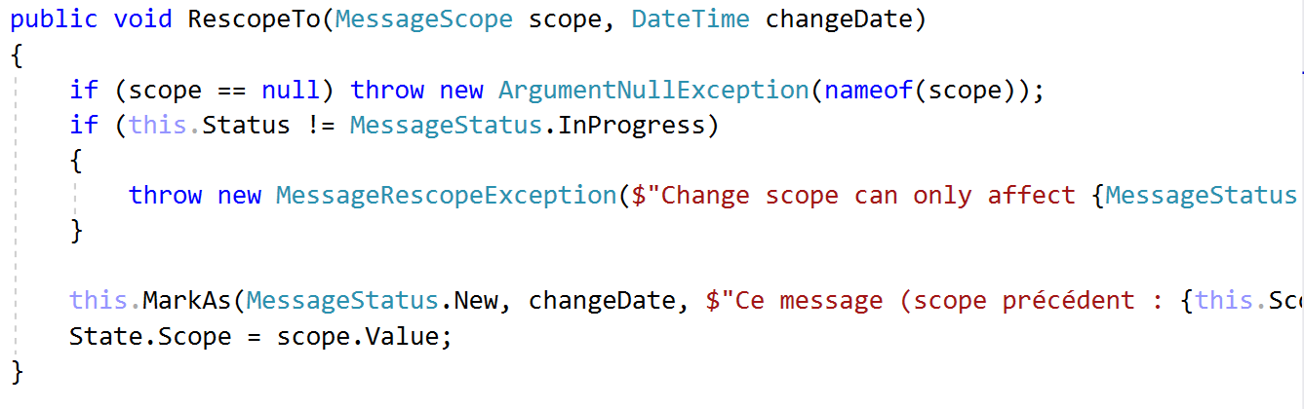
Methods on Domain Entities
Intent-revealing name
Avoid primitive types
Make forbidden state impossible

Slide 33
Status
PRESENTATION
Application Services
Even better
Decoupled
Testable
Easy to know where functionality should live
Explicit models and methods
Clean encapsulation
Meaningful names
Aggregates
DATA
Repositories

Slide 34
What about views ?
We defined
For views / reports we need
Small aggregates
Repositories targeting only Aggregate Roots
Transactional consistency
Repositories hiding data-access
JOINs across many tables
Small ad-hoc queries on some tables
No transactions
Access to raw data / perf
Different needs require different tools

Slide 35
Separating Reads and Writes
Commands vs Queries
Write Model vs Read Model
CQS (Command Query Separation)
CQRS (Command Query Responsibility Segregation)
Aggregates
View-specific projections As big or small as needed

Slide 36
Commands
Queries
Commands
Commands
Queries
Queries
Application Service
Query Handler
WRITE
Load aggregate from repository
Validate / mutate
Save changes
READ
Direct access to the data
Repository
*
* Maybe same as primary, maybe totally different

Slide 37
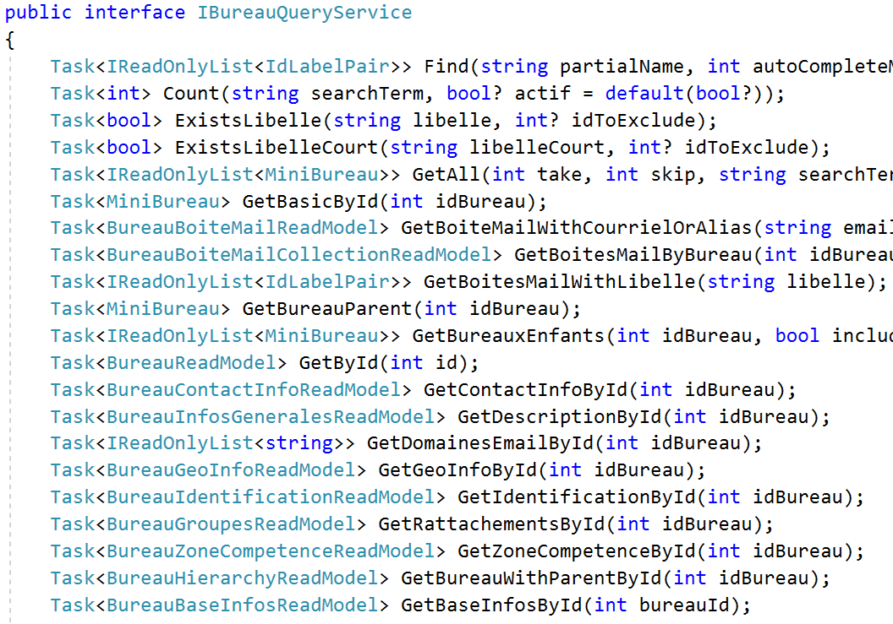
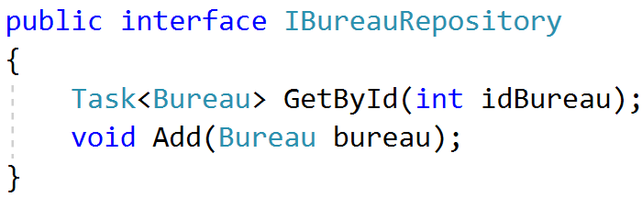
Write Model
Read Model
Expose only Aggregates
Allow edits
Expose projections, DTOs tailored for the view
Read-only

Slide 38

Status
Good enough for now ☺
Decoupled
Testable
Easy to know where functionality should live
Explicit models and methods
Clean encapsulation
Meaningful names
Correct writes
Fast Reads

Slide 39

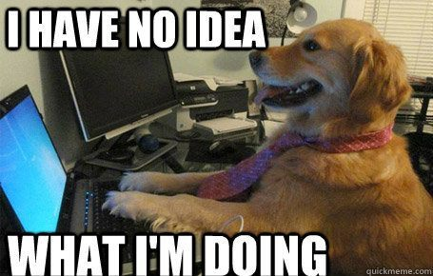
Take aways
Smoothly introduce DDD concepts
Failing is learning
Watch out for smells
Continuously improve
The right tool for the right job
Context is king

Slide 40
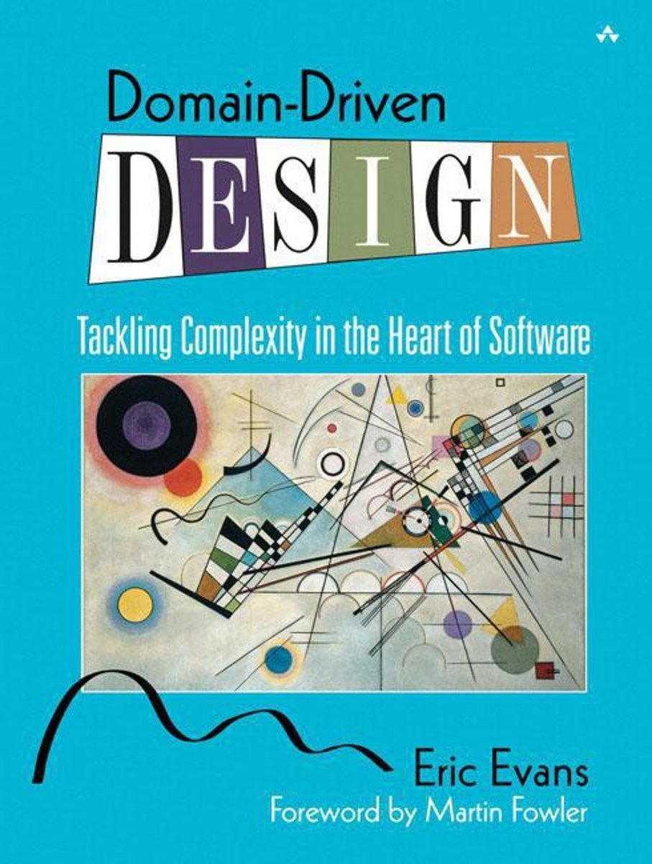
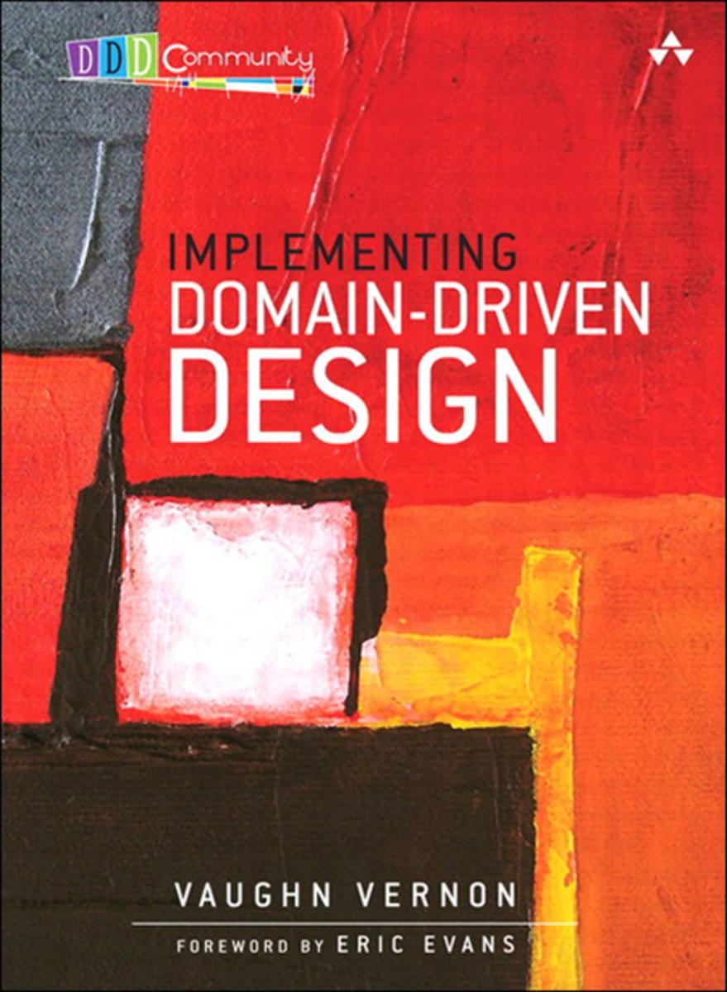
Going further
Some important concepts I left out :
Value Objects
Bounded Contexts
Ubiquitous Language
Domain Events
Context Mapping
…

Slide 41

Thanks for listening !
Questions ?
Thibaud Desodt - @tsimbalar

